Slide 1
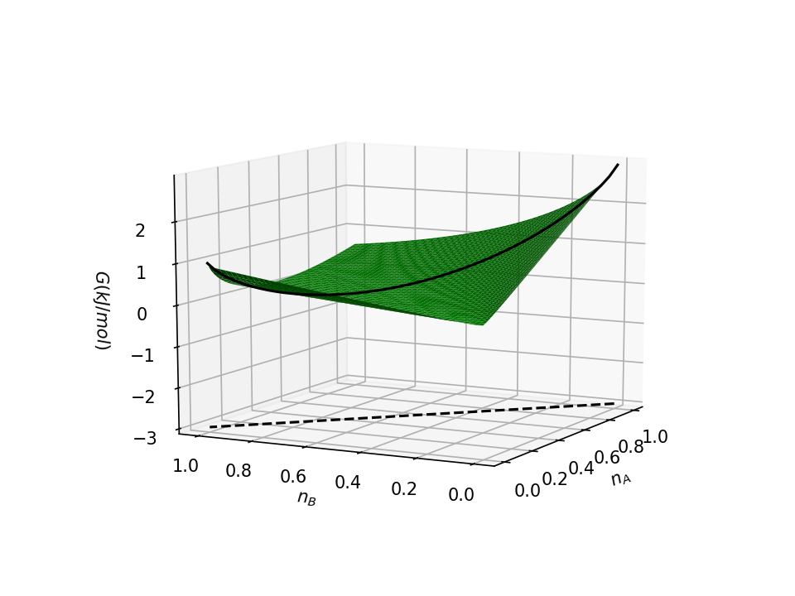
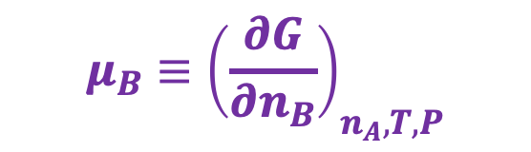
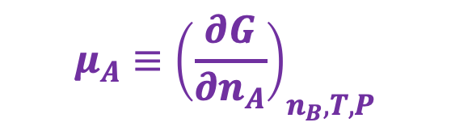
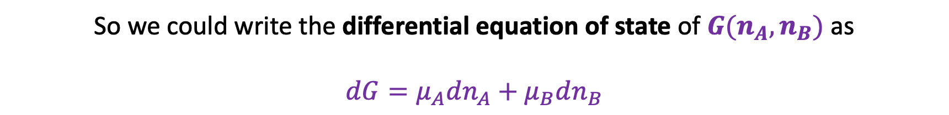
Chemical potentials – they’re just slopes of $G(n_{A}$,$n_{B})$
$$μ_{B}≡{\left(\frac{∂G}{∂n_{B}}\right)}_{n_{A}, T,P}$$
$$G(n_{A},n_{B})$$
$$μ_{A}≡{\left(\frac{∂G}{∂n_{A}}\right)}_{n_{B}, T,P}$$
Reaction path
So we could write the differential equation of state of $G(n_{A},n_{B})$ as
$$dG=μ_{A}dn_{A}+μ_{B}dn_{B}$$

Slide 2
CPF and intuition (A = solute)
X
Y
A(aq)
Chamber X: Solute A is highly concentrated
Chamber Y: Solute A is less concentrated
A(aq)
A(aq)
A(aq)
What direction does your intuition tell you is the direction of spontaneous change?

Slide 3
CPF and intuition (A = solute)
X
Y
A(aq)
Chamber X: Solute A is highly concentrated
Chamber Y: Solute A is less concentrated
A(aq)
A(aq)
A(aq)
What direction does your intuition tell you is the direction of spontaneous change?

Slide 4
CPF and intuition (A = solute)
X
Y
A(aq)
Solutes move from higher concentration to lower concentration
Chamber X: Solute A is highly concentrated
Chamber Y: Solute A is less concentrated
A(aq)
A(aq)
A(aq)
What direction does your intuition tell you is the direction of spontaneous change?

Slide 5
CPF and intuition (A = solute)
X
Y
A(aq)
Solutes move from higher concentration to lower concentration
Chamber X: Solute A is highly concentrated
Chamber Y: Solute A is less concentrated
A(aq)
A(aq)
A(aq)
What direction does your intuition tell you is the direction of spontaneous change?
That means $μ_{A}(X)>μ_{A}(Y)$.

Slide 6
CPF and intuition (A = solute)
X
Y
A(aq)
Solutes move from higher concentration to lower concentration
Chamber X: Solute A is highly concentrated
Chamber Y: Solute A is less concentrated
A(aq)
A(aq)
A(aq)
What direction does your intuition tell you is the direction of spontaneous change?
That means $μ_{A}(X)>μ_{A}(Y)$.
Solutes move from higher chemical potential to lower chemical potential

Slide 7


CPF and intuition (A = gas)
X
Y
Chamber X: Pure oxygen gas
Chamber Y: Air
O₂(g)
O₂(g)
N₂(g)
$$P_{O_{2}}=1. 00 bar$$
$$P_{O_{2}}=0.21 bar$$
What direction does your intuition tell you is the direction of spontaneous change?

Slide 8
CPF and intuition (A = gas)
X
Y
Chamber X: Pure oxygen gas
Chamber Y: Air
O₂(g)
O₂(g)
N₂(g)
$$P_{O_{2}}=1. 00 bar$$
$$P_{O_{2}}=0.21 bar$$
What direction does your intuition tell you is the direction of spontaneous change?

Slide 9
CPF and intuition (A = gas)
X
Y
Chamber X: Pure oxygen gas
Chamber Y: Air
O₂(g)
O₂(g)
N₂(g)
$$P_{O_{2}}=1. 00 bar$$
$$P_{O_{2}}=0.21 bar$$
What direction does your intuition tell you is the direction of spontaneous change?
$$μ_{O_{2}}(X)>μ_{O_{2}}(Y)$$

Slide 10
CPF and intuition (A = gas)
X
Y
Chamber X: Pure oxygen gas
Chamber Y: Air
O₂(g)
O₂(g)
N₂(g)
$$P_{O_{2}}=1. 00 bar$$
$$P_{O_{2}}=0.21 bar$$
What direction does your intuition tell you is the direction of spontaneous change?
$$μ_{O_{2}}(X)>μ_{O_{2}}(Y)$$
Gases move from higher chemical potential to lower chemical potential

Slide 11
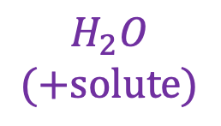
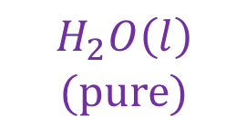
CPF and intuition (A = solvent)
Chamber X is a 1 M solution of NaCl(aq). Chamber Y is pure water.
X
Y
$$H_{2}O$$
$$(+solute)$$
$$H_{2}O\left(l\right)$$
$$(pure)$$

Slide 12
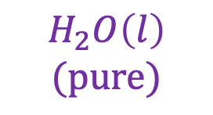

CPF and intuition (A = solvent)
Chamber X is a 1 M solution of NaCl(aq). Chamber Y is pure water.
X
Y
$$H_{2}O$$
$$(+solute)$$
$$H_{2}O\left(l\right)$$
$$(pure)$$

Slide 13
CPF and intuition (A = solvent)
Chamber X is a 1 M solution of NaCl(aq). Chamber Y is pure water.
X
Y
$$μ_{H_{2}O}\left(X\right)<μ_{H_{2}O}(Y)$$
$$H_{2}O$$
$$(+solute)$$
$$H_{2}O\left(l\right)$$
$$(pure)$$
Solvents move from higher chemical potential to lower chemical potential

Slide 14
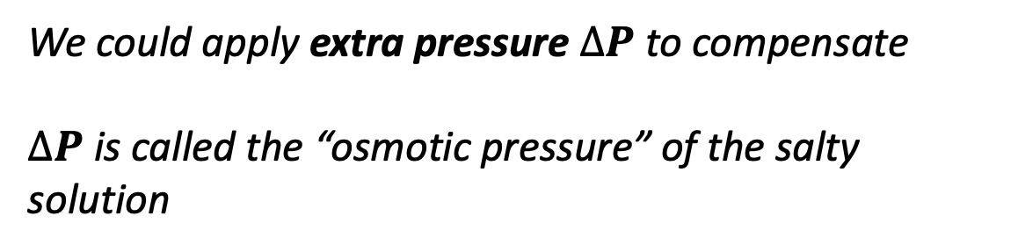

CPF and intuition (A = solvent)
Chamber X is a 1 M solution of NaCl(aq). Chamber Y is pure water.
$$∆P$$
Y
X
We could apply extra pressure $∆P$ to compensate
$∆P$ is called the “osmotic pressure” of the salty solution
$$H_{2}O$$
$$(+solute)$$
$$H_{2}O\left(l\right)$$
$$(pure)$$

Slide 15
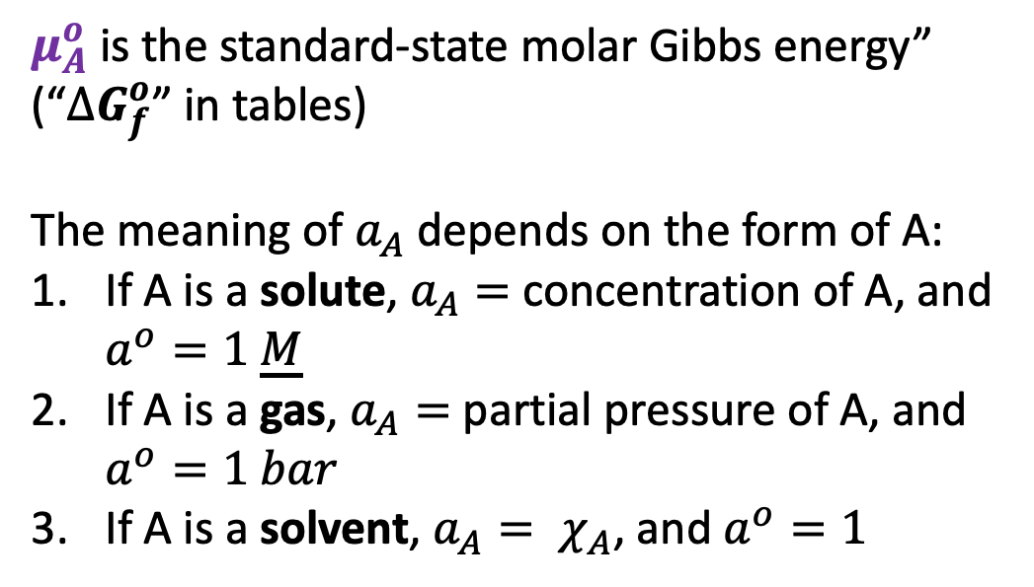
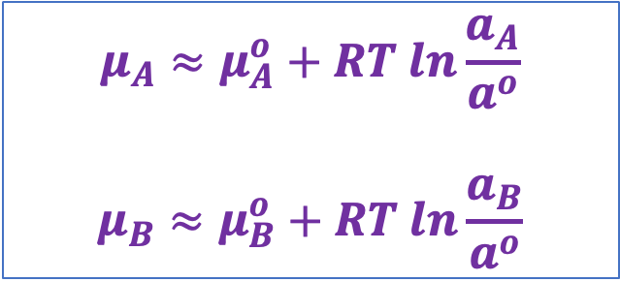
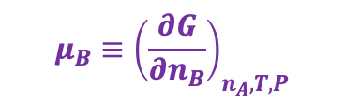
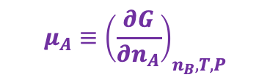
How do we get chemical potentials? The “CPF” (for chemical potential function)
$$μ_{A}≈μ_{A}^{o}+RT ln\frac{a_{A}}{a^{o}}$$
$$μ_{B}≈μ_{B}^{o}+RT ln\frac{a_{B}}{a^{o}}$$
The CPF
$$μ_{B}≡{\left(\frac{∂G}{∂n_{B}}\right)}_{n_{A}, T,P}$$
$$G(n_{A},n_{B})$$
$$μ_{A}≡{\left(\frac{∂G}{∂n_{A}}\right)}_{n_{B}, T,P}$$
$μ_{A}^{o}$ is the standard-state molar Gibbs energy” (“${∆G}_{f}^{o}$” in tables)
The meaning of $a_{A}$ depends on the form of A:
If A is a solute, $a_{A}=$ concentration of A, and $a^{o}=1 \underline{M}$
If A is a gas, $a_{A}=$ partial pressure of A, and $a^{o}=1 bar$
If A is a solvent, $a_{A}= χ_{A}$, and $a^{o}=1$

Slide 16
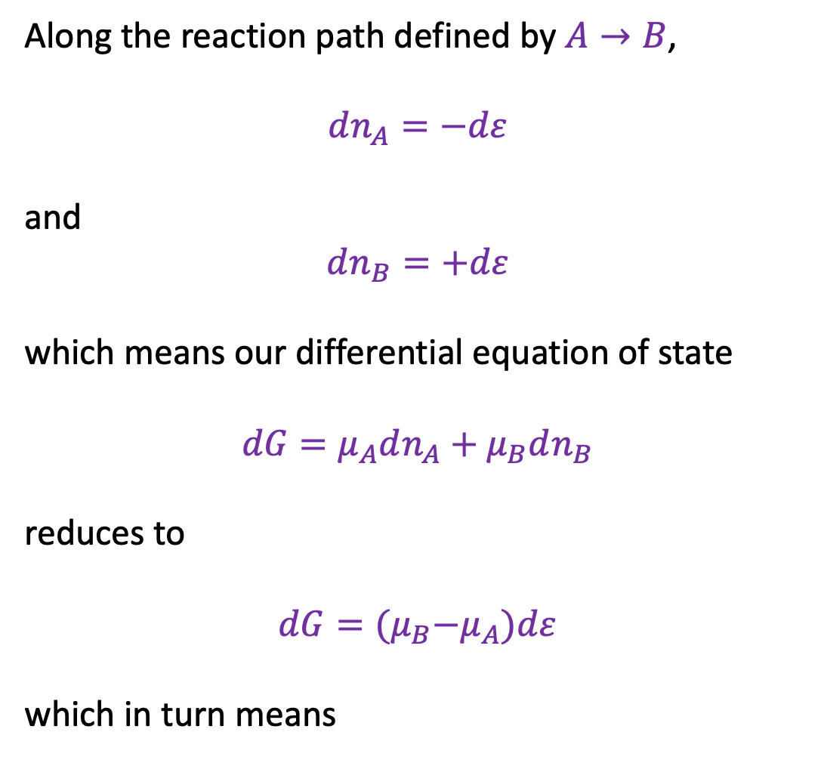


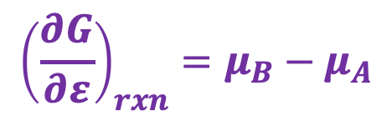
Chemical potentials along a reaction path
Along the reaction path defined by $A→B$,
$dn_{A}=−dε$
and
$$dn_{B}=+dε$$
which means our differential equation of state
$$dG=μ_{A}dn_{A}+μ_{B}dn_{B}$$
reduces to
$$dG={(μ}_{B}−μ_{A})dε$$
which in turn means
$$dn_{A}$$
$$dn_{B}$$
$${\left(\frac{∂G}{∂ε}\right)}_{rxn}=μ_{B}−μ_{A}$$

Slide 17

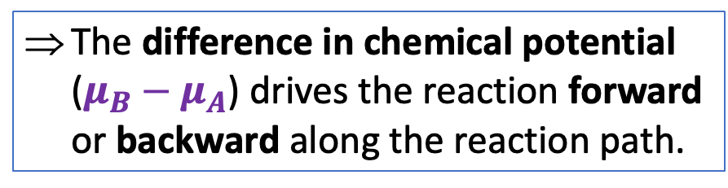
Chemical potentials along a reaction path
Along the reaction path defined by $A→B$,
$dn_{A}=−dε$
and
$$dn_{B}=+dε$$
which means our differential equation of state
$$dG=μ_{A}dn_{A}+μ_{B}dn_{B}$$
reduces to
$$dG={(μ}_{B}−μ_{A})dε$$
which in turn means
$$dn_{A}$$
$$dn_{B}$$
The difference in chemical potential ($μ_{B}−μ_{A}$) drives the reaction forward or backward along the reaction path.
$${\left(\frac{∂G}{∂ε}\right)}_{rxn}=μ_{B}−μ_{A}$$

Slide 18
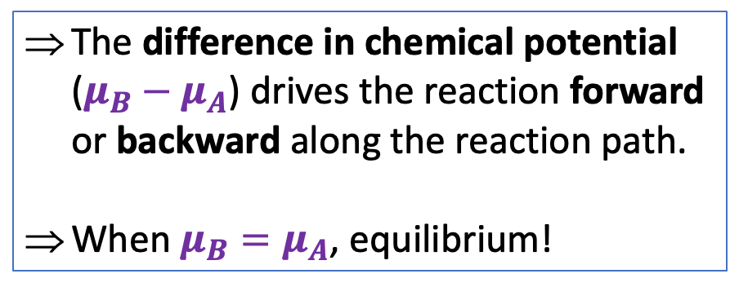
Chemical potentials along a reaction path
Along the reaction path defined by $A→B$,
$dn_{A}=−dε$
and
$$dn_{B}=+dε$$
which means our differential equation of state
$$dG=μ_{A}dn_{A}+μ_{B}dn_{B}$$
reduces to
$$dG={(μ}_{B}−μ_{A})dε$$
which in turn means
$$dn_{A}$$
$$dn_{B}$$
The difference in chemical potential ($μ_{B}−μ_{A}$) drives the reaction forward or backward along the reaction path.
When $μ_{B}=μ_{A}$, equilibrium!
$${\left(\frac{∂G}{∂ε}\right)}_{rxn}=μ_{B}−μ_{A}$$

Slide 19
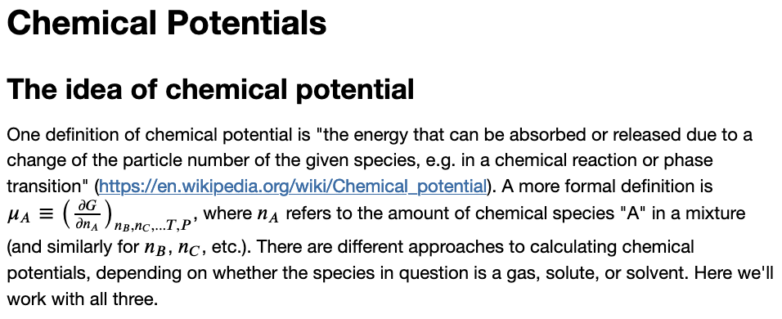
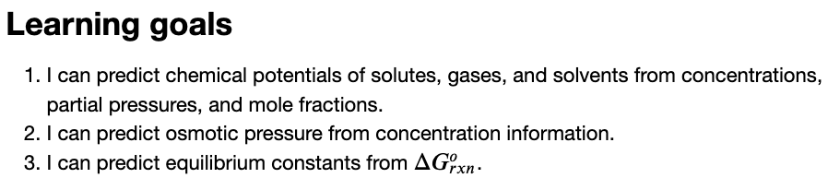
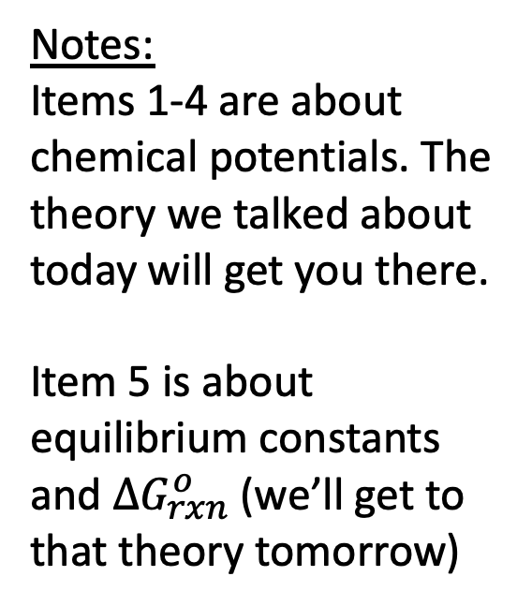
The CGI associated with this
Notes:
Items 1-4 are about chemical potentials. The theory we talked about today will get you there.
Item 5 is about equilibrium constants and $∆G_{rxn}^{o}$ (we’ll get to that theory tomorrow)

